Slide 1

Microwave oven simulation using PICsimlab
EMERTXE INTERNSHIP
TEAM DETAILS:
Y.N.S. Harsha , 3rd year ECE
P.S.V. Tanooj , 3rd year ECE

Slide 2
Contents
Course objective
Project implementation
What we learned
Embedded systems
Embedded c programming
Microcontrollers vs Microprocessors
Interrupts and timers
Requirements
Demo

Slide 3

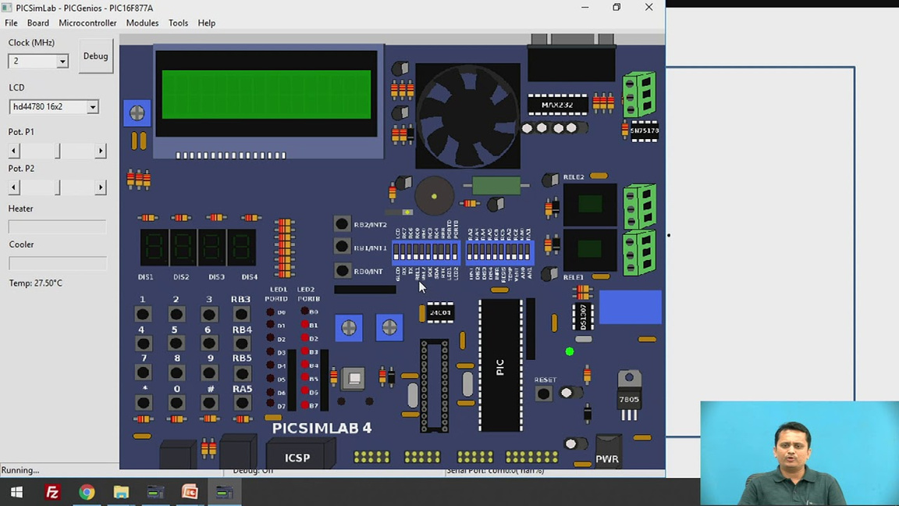
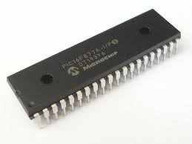
What we learned:
C laguage basics to advanced :
Data types
Conditional statements
Loops
Operators
Arrays, Address & Pointers
Storage classes
Implementation of project :
Mp lab IDE
PICsimlab
Embedded systems & microcontrollers
Timers & interrupts
Project implementation

Slide 4
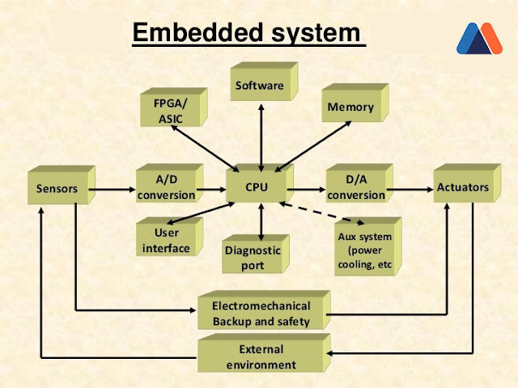
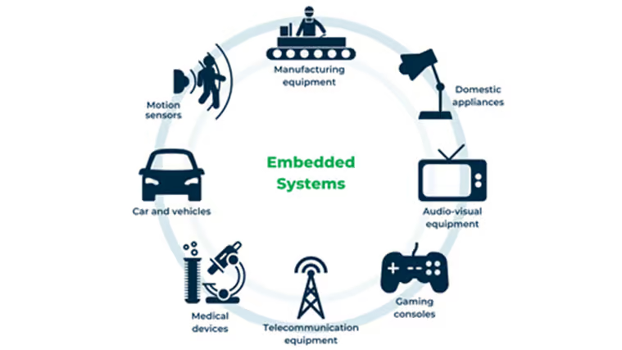
Embedded systems
What is an Embedded System?
An embedded system is a combination of hardware and software designed to perform a specific task.
Household appliances: washing machines, TVs, dishwashers
Automobiles: airbag systems, navigation, automatic wipers
Mobile phones, healthcare devices

Slide 5
Embedded C Programming
Why Use Embedded C?
Fixed memory usage for efficiency
Hardware control capability
Reliable, compact, and efficient code
Features of C Language for Embedded Systems:
Reusable code which can be expanded with new modules
Runs on multiple hardware & OS platforms
Key Elements of C Programming:
Data Types: Character (1 byte), Integer (4 bytes), Float (4 bytes), Double (8 bytes)
Operators: Arithmetic, Logical, Relational, Bitwise, Assignment
Control Statements: If, If-Else, Switch, For, While, Do-While
Pointers & Functions: Used for memory management
Storage Classes: Auto, Static, Register, etc.
Preprocessor Directives: #define, #include, #ifdef

Slide 6
Microcontrollers vs. Microprocessors
What is a Microcontroller?
A microcontroller (MCU) is a small computer on a single integrated circuit that is designed to control specific tasks within electronic systems. It combines the functions of a central processing unit (CPU), memory, and input/output interfaces, all on a single chip.
What is a Microprocessor?
A Microprocessor is an important part of a computer architecture without which you will not be able to perform anything on your computer. It is a programmable device that takes in input performs some arithmetic and logical operations over it and produces the desired output.
For this project we are using PIC16F877A micro controller

Slide 7
Timers and Interrupts
What is a Timer?
A timer in a microprocessor is a counter that measures time and can be used to trigger events. Timers are used in many embedded systems and applications.
Timers in PIC16F877A: PIC16F877A has three timers for delay generation, counting, and PWM control.
Timer0 (8-bit)
Counts from 0 to 255
Works as timer (internal clock)
or counter (external clock)
Prescaler (1:1 to 1:256)
Used for delays, event counting
Registers: TMR0, OPTION_REG
Timer1 (16-bit)
Counts from 0 to 65535
Works as timer or counter
Prescaler (1:1, 1:2, 1:4, 1:8)
Used for real-time clocks (RTC), frequency measurement
Registers: TMR1H, TMR1L, T1CON
Timer2 (8-bit with Postscaler)
Works as a timer only
Prescaler (1:1 to 1:16), Postscaler (1:1 to 1:16)
Used for PWM generation, periodic interrupts
Registers: TMR2, T2CON, PR2

Slide 8
Timers and Interrupts
What is an Interrupt?
An interrupt in a microprocessor is a signal that tells the processor to stop its current task and handle a specific event. Interrupts can be caused by hardware or software.
Interrupts in PIC16F877A: Interrupts allow the microcontroller to pause main execution and execute a special function (ISR).
Types of Interrupts:
External Interrupt (Triggered on RB0/INT pin)
Timer Interrupts (Timer0, Timer1, Timer2 overflow)
Peripheral Interrupts (UART, ADC, CCP, etc.)
Important Registers:
INTCON (Global and Peripheral Interrupt Control)
GIE (Global Interrupt Enable)
PEIE (Peripheral Interrupt Enable)
T0IE, INTE (Timer0, External INT Enable)
PIR1, PIR2 (Interrupt Flag Registers)
PIE1, PIE2 (Interrupt Enable Registers)

Slide 9
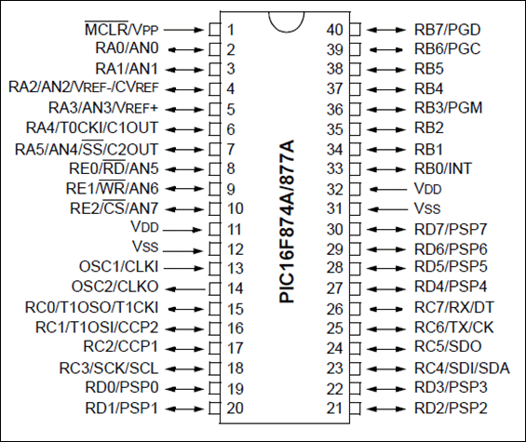
Requirements for the Microwave Oven Project
Tools & Components Used:
MPLAB IDE for coding
XC8 Compiler for compiling
PICsimLAB for simulation
Microcontroller: PIC16F877A
Peripherals Used :
LED Indicators
Connected to PORT B & D
Logic 1 (High): LED ON & Logic 0 (Low): LED OFF
Character LCD Display (CLCD)
Displays mode selection, time, and temperature
Types Used: 16x2, 16x4 LCD
Data transmission modes:
4-bit mode (4 data lines: RD4 - RD7)
8-bit mode (8 data lines: RD0 - RD7)
Tactile Switches (Keypad Input)
Used to select the mode and enter temperature/time
Key Debouncing Issue: Needs software correction
Matrix Keypad & Input Handling
Rows (4) connected to PORT D & Columns (3) connected to PORT B
Working Principle:
All pins HIGH initially
When a key is pressed, corresponding row/column becomes LOW

Slide 10
DEMO

